Slide 1
CDU IT Code Fair 2026
The Long Way to Care
Team DIC031:
Chepngenoh Chepkwony
Cynthia Ebele Ikegbunam
Notes:
[0:00 to 0:15] Hello everyone, we are Team DIC 031. Our question is simple: in an emergency in a remote Northern Territory community, can you call for help, and can you reach care?

Slide 2
The problem
No confirmed signal
  429 of 782 communities (54.9%) have no confirmed way to call for help
Never recorded
  423 are missing from the NT Government coverage list, so nobody has confirmed a signal
Listed as none
  6 are listed as having no coverage
Notes:
[0:15 to 0:50] In an emergency you need to call for help, and then reach care. We joined mobile coverage records, road drive times and clinic contact lists for 782 remote communities, outstations and town camps. Look at the chart: 423 communities were never recorded in the NT Government list, and 6 are listed as having no coverage. That is 429, or 54.9 percent, with no confirmed way to call for help. The blue bars are the 353 with some confirmed coverage. 'Never recorded' does not prove there is no signal. It means nobody has confirmed one. That is the gap.

Slide 3




One score, four ways a community can be cut off
HOW WE MEASURED IT
Can they call?
Nearest clinic
Nearest hospital
Sealed road?
Confirmed mobile coverage from the NT lists and 2025 tower registers
Road drive time to the closest remote clinic
Road drive time to a hospital emergency department
Whether a sealed road connects the place
Equal-weighted mean
Gap Index, 0 to 1
Four risk tiers
Nine sources, 782 places. Alternative weightings gave the same top 20 (Spearman ρ ≥ 0.99).
Notes:
[0:50 to 1:30] We built one transparent score, the Gap Index, from nine sources for 782 places. It has four ingredients: can they call, how far is the nearest clinic, how far is the nearest hospital, and is there a sealed road. Each is rank-scaled from zero to one and averaged with equal weights, then split into four risk tiers, Low to Critical. Where a drive time cannot be calculated because the place is too remote to route, we score it as maximum risk instead of dropping it. We tested other weightings and got the same top twenty communities, with a correlation above 0.99, so we kept it simple.

Slide 4
What we found
Far from a hospital
  Median road trip is 3h 56m; 340 places are over 4 hours away
Cut off by road
  85 places have no mapped road to a hospital; 469 have 20 km+ unsealed
Thin emergency cover
  49 of 91 clinics list no 24/7 emergency service
Notes:
[1:30 to 2:30] Here is what the data shows. The median road trip from a remote place to a hospital emergency department is three hours fifty-six minutes, and 340 places are more than four hours away, 191 of them more than six. The chart shows the spread. Eighty-five places have no mapped road to any hospital. 469 places have 20 kilometres or more of unsealed road on their fastest route, so they risk being cut off in the wet season. And clinics are not a full answer: 49 of the 91 remote clinics list no 24/7 emergency service. Put together, 210 communities that cannot call for help have, as their nearest clinic, one with no listed 24/7 service. These drive times assume the dry season, so they are best-case figures.

Slide 5
Who is most at risk
Place or group | Measure | Value | What it shows
Tennant Creek | Gap Index | 0.012 | Near the best-off end
East Arnhem region | Mean Gap Index | 0.720 | High regional average
16 communities | Gap Index | 1.000 | Tied at the maximum
Critical tier | Family Outstations | 98% | Small, kin-based homelands
Notes:
[2:30 to 3:10] The gap is not spread evenly. 98 percent of Critical-tier communities are Family Outstations, small kin-based homelands, so the service gap follows people home. Sixteen communities tie at the maximum score of 1.000. Compare Tennant Creek at 0.012. Region matters too: East Arnhem's average Gap Index is 0.720. One caution: the official coverage lists are a guide only, so this is a prompt to verify with communities and health services, not a verdict on any community.

Slide 6
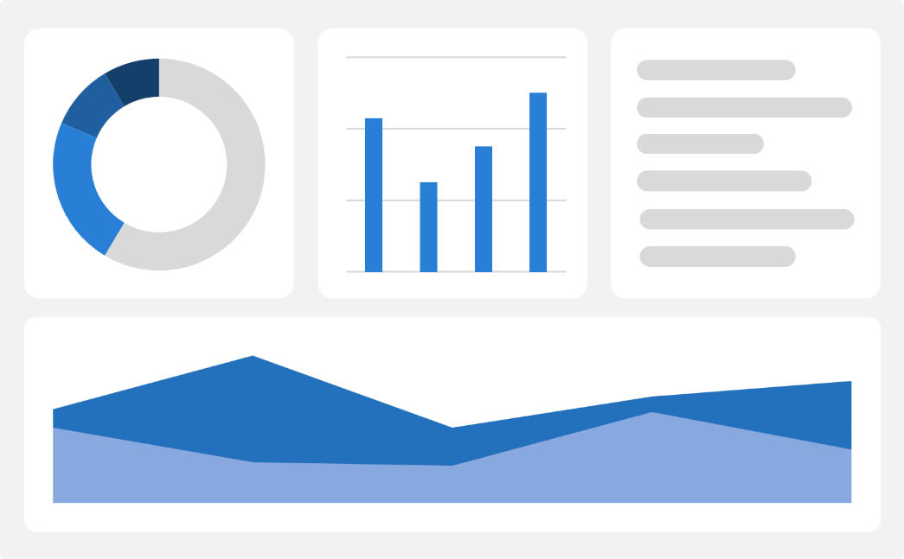
The prototype
Search a community or a clinic
See coverage, drive times and risk tier
Act: clinic phone, hours, 24/7 status
One HTML file, no internet or install
Works in any web browser
Coverage-gap report saved on the device
Notes:
[3:10 to 4:00] Analysis only helps if it reaches the people who need it, so we built a working prototype. It is a single offline dashboard file. You search a community or a clinic, see whether a call for help is likely to connect, how far care is, and who to phone, including the clinic's hours and whether it has a 24/7 service. It needs no internet, no server and no installation, so it works in the places the data says have the least signal. There is also a form to report a coverage gap, which saves on the device. [Optional live demo: open dashboard_offline.html, search Kumunu, then a clinic.]

Slide 7
Recommendations
Connect
Cover the Critical
tier first
Close
Fix the 24/7 gap for 210 communities
Share
Put the dashboard in local health services
Connect the Critical tier first: prioritise coverage and a confirmed emergency-call option
Close the 24/7 gap for the 210 communities that cannot call
Put the dashboard in local hands through remote health services and Aboriginal community-controlled health organisations
Notes:
[4:00 to 4:30] Three recommendations. One: government and telecommunications providers should connect the Critical tier first. Two: close the 24/7 gap, starting with the 210 communities that cannot call and whose nearest clinic lists no 24/7 service. Three: put the dashboard in local hands, through remote health services and Aboriginal community-controlled health organisations.

Slide 8
Summary
429 of 782 remote NT communities have no confirmed way to call for help, and care can be hours away by road.
We used no personal or health records. Missing data is scored as maximum risk, never dropped. Results are for co-design with communities, not a verdict on any of them.
A transparent Gap Index
Four risk tiers, 782 places
An offline, searchable dashboard
Recommendations for government and health services
Notes:
[4:30 to 4:50] To sum up: 429 of 782 remote communities have no confirmed way to call for help, and care can be hours away. On ethics: we used no personal or health records, the unit of analysis is a place's access to help, missing data is scored as maximum risk rather than hidden, and the results are meant to be taken to communities for verification and co-design.

Slide 9
Thank you
Chepngenoh Chepkwony
Cynthia Ebele Ikegbunam
The Long Way to Care
Notes:
[4:50 to 5:00] The gap is measurable, and now it is visible. Thank you. We would be glad to take your questions.

